Slide 1






Twitter and it’s impact on NASDAQ
Tara Flynn, Sam Choi, Peter Chen, Sumed

Slide 2
Project Summary and Selection Journey

Slide 3

Project Summary
Objective:
Identifying correlation between Stocks and Tweets.
We are using the top 5 NASDAQ stocks (Apple, Amazon, Tesla, Microsoft, and Google)
Does Twitter activity affect opening and closing prices in the market?
Does Twitter activity predict stock liquidity?
Identify correlation and utilize machine learning to test our our hypothesis and replicate accuracy and precision through machine learning models.

Slide 4
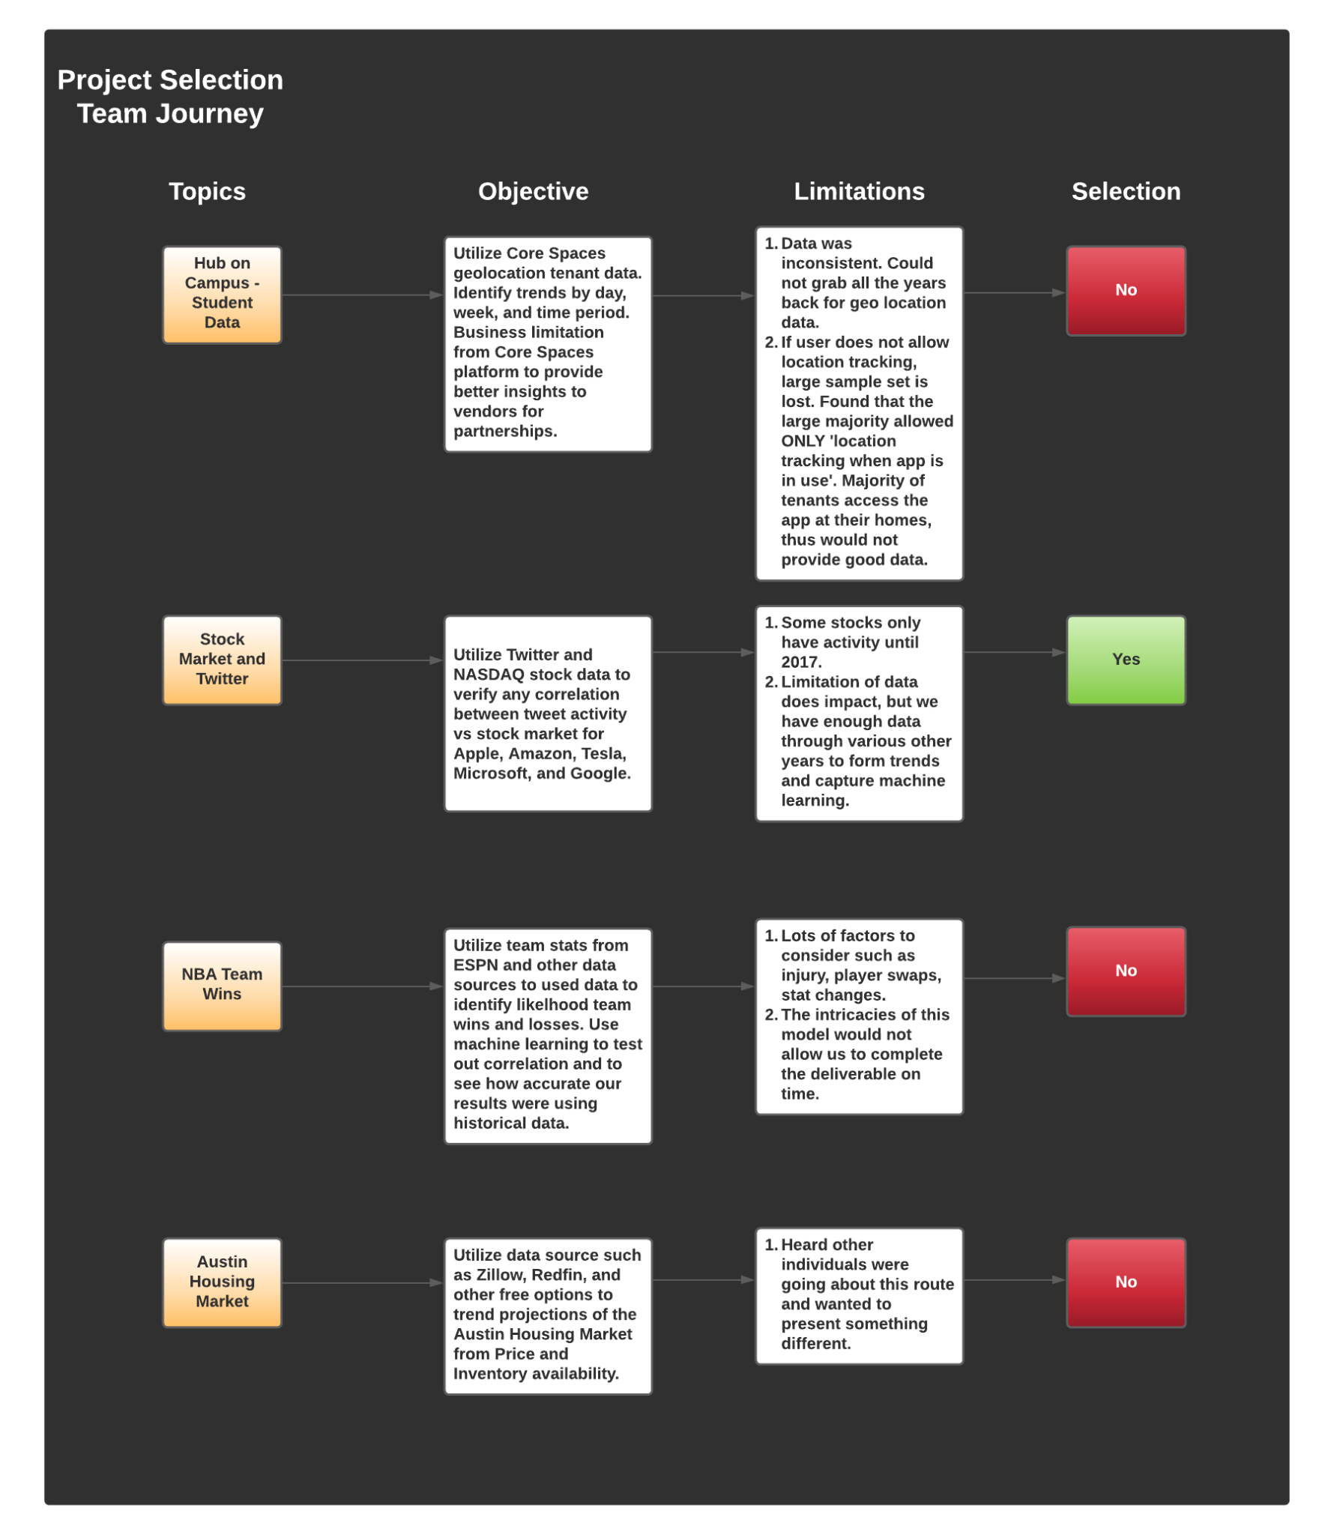
Project Selection Journey
Objective: Choosing the Topic
We researched 4 different topics from various different sectors of industry.
The final selection, ‘Stock Market and Tweets’ was selected after reviewing objective, needed technology, and limitations from the available data sets.
For easier viewing of the journey model, CLICK HERE.

Slide 5
Data Source

Slide 6
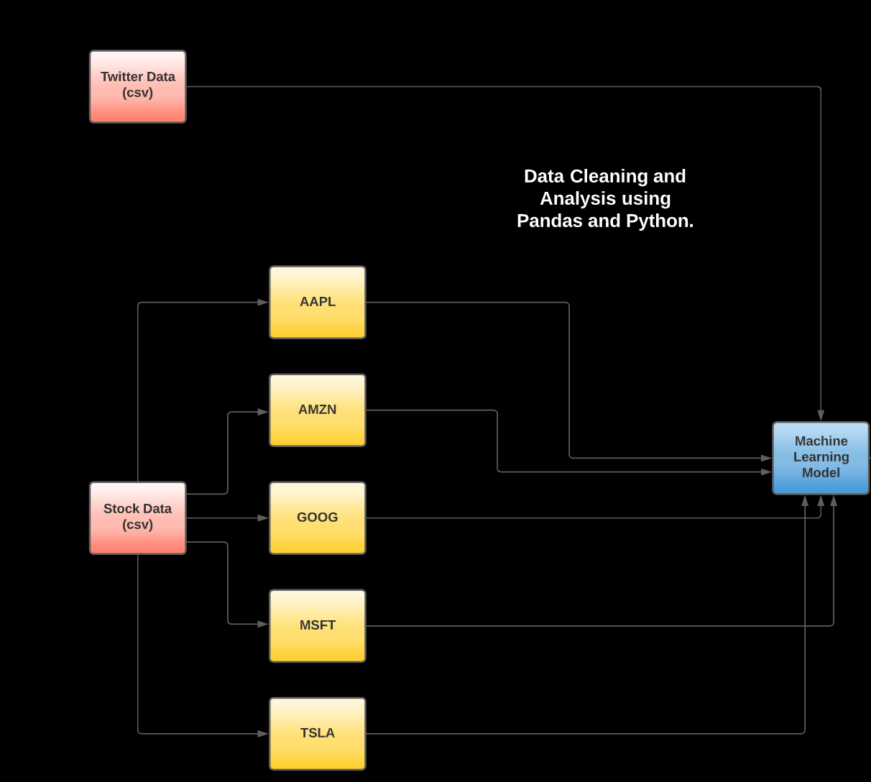
Data Source
Source:
Data for Stocks (Amazon, Apple, Microsoft, Tesla, and Google) were obtained in csv format through kaggle.
Data for Tweets through 2015 - 2019 were obtained in csv format through Kaggle.

Slide 7
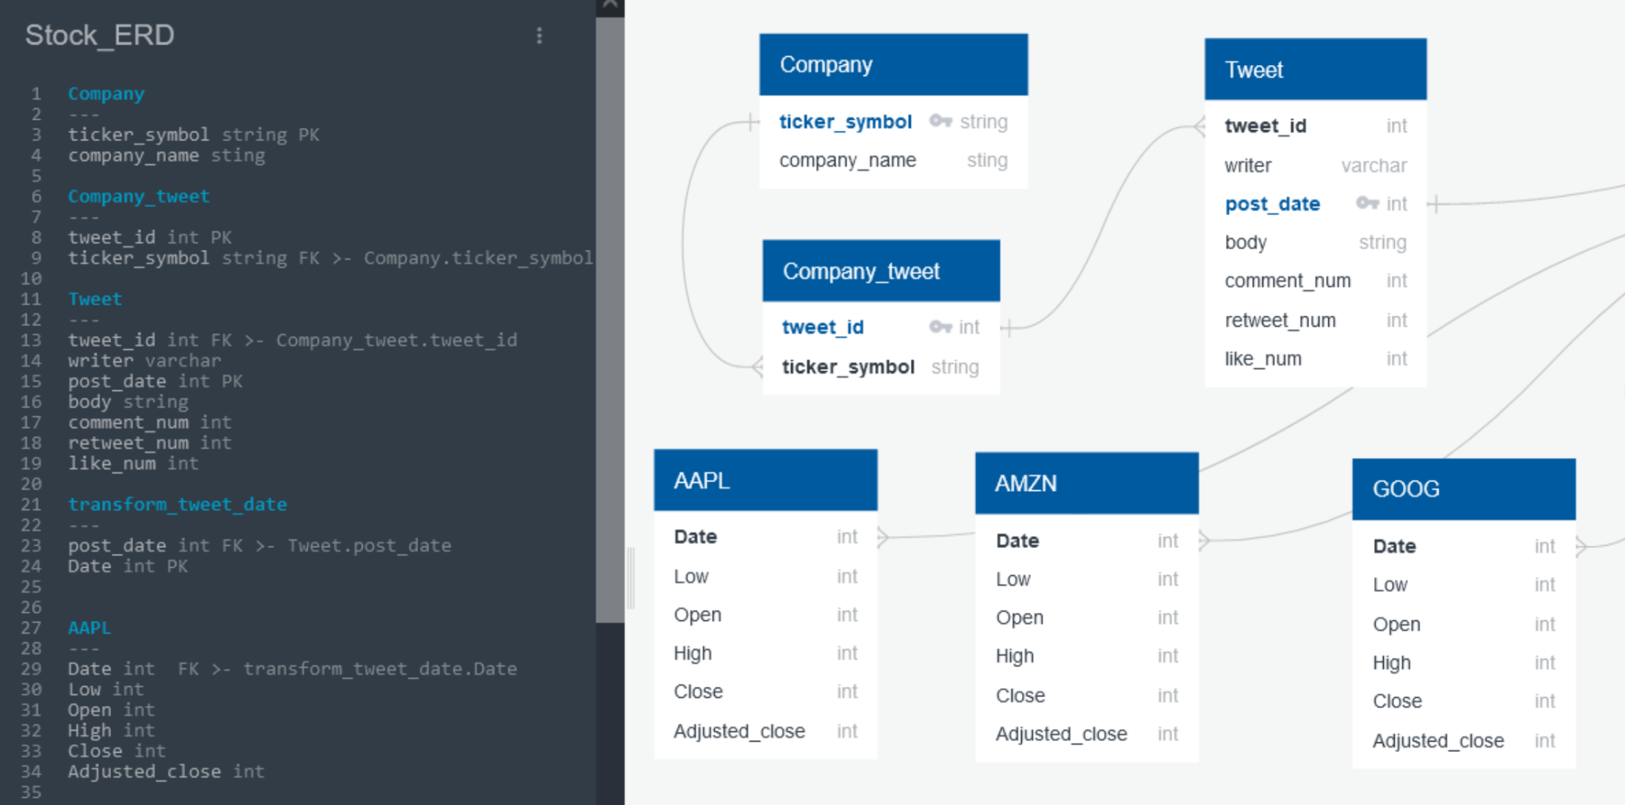
Data Source: ERD

Slide 8
Discovery, Data Exploration, and Data Analysis

Slide 9

Discovery: Questions to Answer
What level of correlation and predictability can be gathered to test out our hypothesis that tweets impact stocks in terms of prices or stock volume transactions?
Which primary and foreign keys can be utilized to JOIN these data sets together for use?
Are there key points within the year where stock prices and volume transactions go up naturally with or without influence from twitter end users and influencers?
Can this be tested through supervised learning to replicate results from SKLearn train-test-split?
If so, what is the best model to use for machine learning that will not over fit or under fit?
What can I solve/answer with this data?

Slide 10
Discovery: Data Exploration and Analysis
The team uploaded csvs (stocks and tweets) into Amazon S3 and connected to PgAdmin Postgres. S3 was also connected to a Jupyter Notebook database for use with Python and Pandas.
Stocks and Tweets were joined based on stock company ticker through python and postgres.
We identified null data sets from Tweets and Stocks and dropped any ‘N/A’ and ‘Null Values’.
Dates were formatted for acceptable use for postgres and python work.

Slide 11
Discovery: Data Exploration and Analysis pt 2
Calculated fields were created for price action from the delta of opening and closing stock prices. These were compared with tweet volume counts tied to each day.
All stock dataframes were consolidated into 1 master table to capture all information for use of data analysis.
Data went through pre-viz using matplotlib pyplot to understand distribution of daily percent price changes. Identified the mean as well as all quartile ranges for each stock.
Final-viz using Tableau illustrations.
Supervised machine learning model using Pandas and SKLearn libraries
Variables were price action and tweet counts.
Correlation was found on stock liquidity/volume quantity exchange.
No strong correlation between price action vs tweet activity.

Slide 12
Tableau Storyboard: Blue Prints → Construction

Slide 13
Data Analysis: Tableau
Link to Tableau Public Dashboard - CLICK HERE
Analysis of Tweet Impacts on Stock Prices:
Tweet Volume
Aggregate Price Action Over Time
Tweet Volume vs Stock Volume
Tweet Volume vs Price Volume
Tweet Engagement:
Popular Authors
Tweets with more than 1,000+ engagement

Slide 14
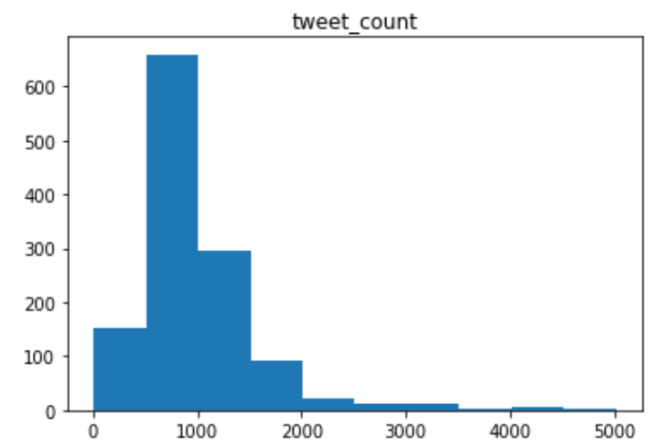
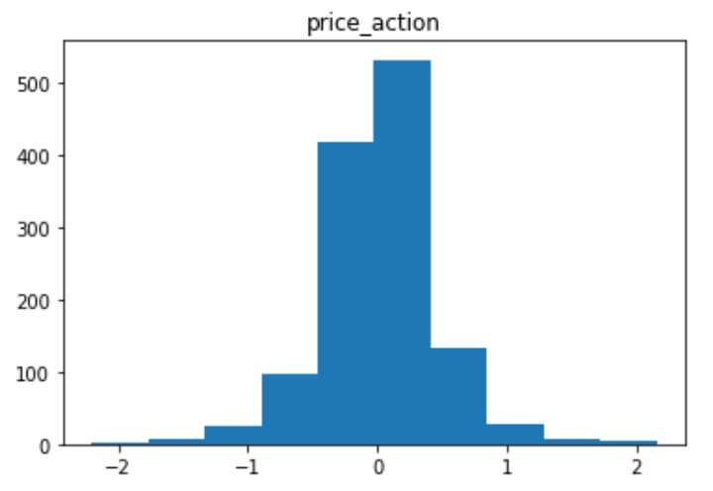
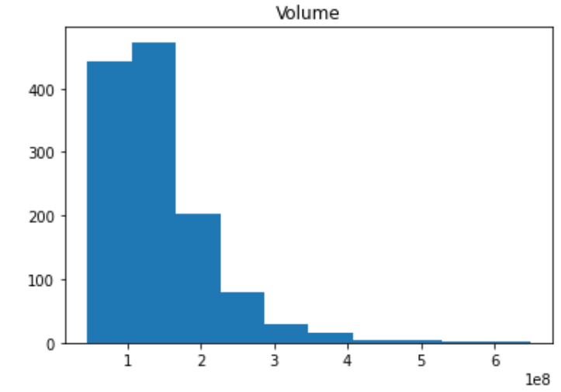
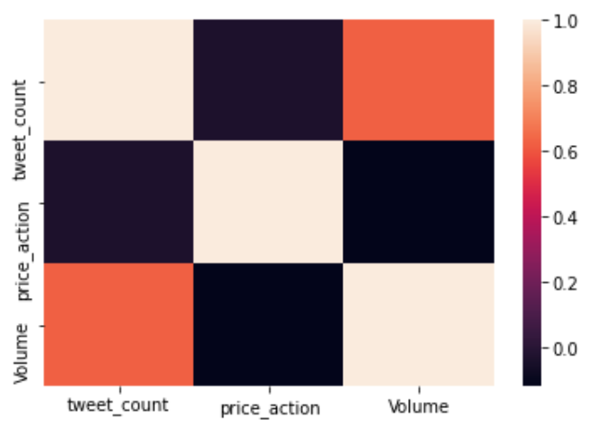
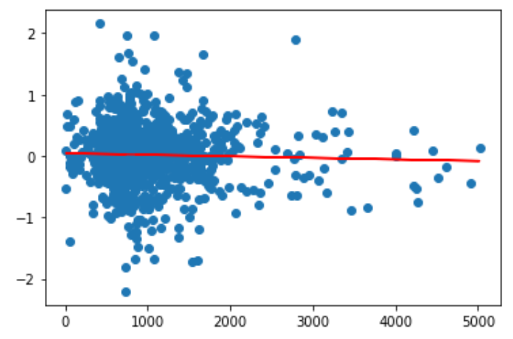
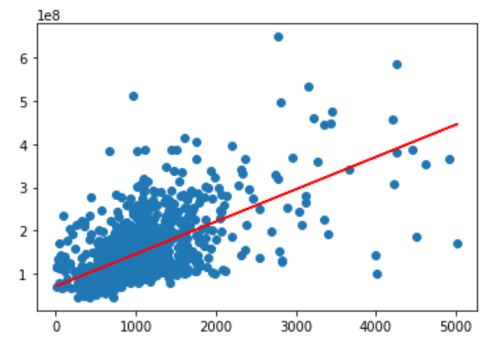
Data Analysis: Machine Learning (Apple)

Slide 15
Data Analysis: Tableau
Link to Tableau Public Dashboard - CLICK HERE
Analysis of Tweet Impacts on Stock Prices:
Tweet Volume
Aggregate Price Action Over Time
Tweet Volume vs Stock Volume
Tweet Volume vs Price Volume
Tweet Engagement:
Popular Authors
Tweets with more than 1,000+ engagement

Slide 16
Technology Used

Slide 17
Technology Used
Data Cleaning and Analysis:
Excel and Panda were used to clean the data and perform an exploratory analysis. Python was used for further drill down analysis and data manipulation.
Database Storage:
Amazon RDS, PgAdmin, and S3 buckets were used to store our raw and cleaned csv data.
Machine Learning:
SKLearn was used as our Machine Learning Library.
Logistic Regression
Standard Scaler Train-Test-Split (75:25)
Tensor Flow: Train-Test-Split (75:25)
6 nodes; Relu model (first hidden layer); Sigmoid (output layer)
Dashboards:
Tableau was used for visualization presentation on all of our finds and ML predictions.

Slide 18
Thank you!

